Slide 1
Convolutional Neural Network

Slide 2
Convolutional
Neural Network
CNN
https://cs231n.github.io/convolutional-networks/

Slide 3
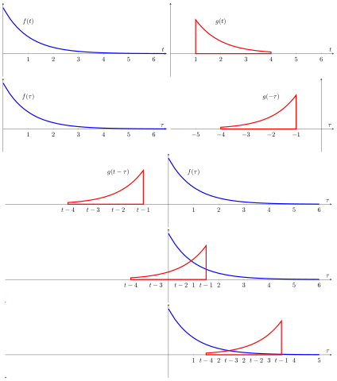
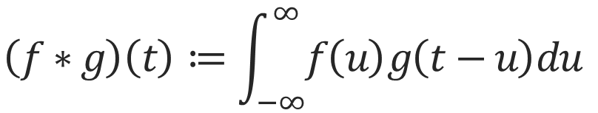
Convolution
$$\left(f∗g\right)\left(t\right)≔\int_{−∞}^{∞}{f\left(u\right)g\left(t−u\right)du}$$
참고 : https://en.wikipedia.org/wiki/Convolution

Slide 4
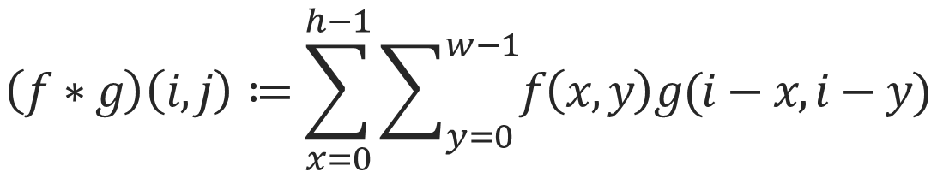
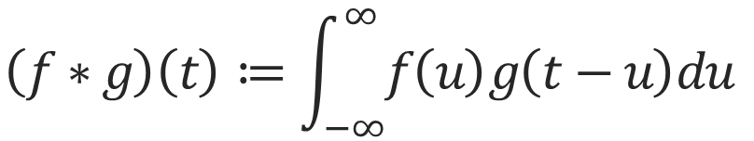
CNN
CNN is Multiplication by Element
$$\left(f∗g\right)\left(t\right)≔\int_{−∞}^{∞}{f\left(u\right)g\left(t−u\right)du}$$
$$\left(f∗g\right)\left(i,j\right)≔\sum_{x=0}^{h−1}{\sum_{y=0}^{w−1}{f\left(x,y\right)g(i−x,i−y)}}$$

Slide 5
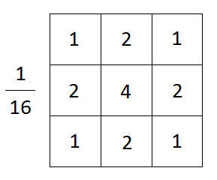
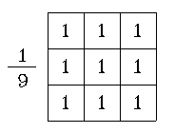
Filter
Spatial Smoothing Filtering
Gaussian Filter
Average Filter
참고 : https://wjrmffldrhrl.github.io/digital9/

Slide 6
Filter
1
0
0
1
0
0
1
1
0
1
0
0
1
0
0
1
0
0
1
0
0
1
0
0
1
1
1
1
1
1
1
0
0
1
0
0
1
0
0
1
0
0
1
0
0

Slide 7
Filter
1
0
0
1
0
0
1
1
0
1
0
0
1
0
0
1
0
0
1
0
0
3
1
0
3
1
0
0
1
1
1
1
1
1
3
2
1
3
1
0
0
1
0
0
1
0
0
3
1
1
3
1
0
0
1
0
0
3
1
1
3
Edge extraction

Slide 8
Pooling
3
1
0
3
3
2
3
2.x
1
1.x
3
2
1
3
3
2
3
2.x
1.x
2
3
1
1
3
3
1
3
2
1
2
3
1
1
3
2x2 maxpooling
2x2 avgpooling

Slide 9
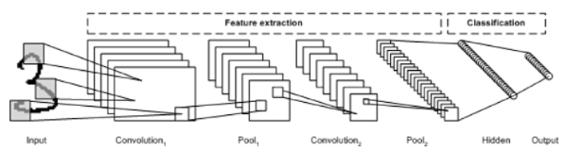
CNN
Architecture
참고 : http://taewan.kim/post/cnn/

Slide 10
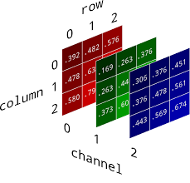
CNN
Channel
What is Channel?
3-Channel
CNN Convolution Layer increases the Channel

Slide 11
CNN
Channel
CNN Convolution Layer increases the Channel
w
w
w
w
w
w
w
w
w
w
w
w
w
w
w
w
w
w
w
w
w
w
w
w
w
w
w
w
w
w
w
w
w
w
w
w
w
w
w
w
w
w
w
w
w
w
w
w
w
w
w
w
w
w
w
w
w
w
w
w
w
w
w
w
w
w
w
w
w
w
w
w
w
w
w
w
w
w
w
w
w
w
w
w
w
w
w
w
w
w
Filter
9-channel-Filter

Slide 12
CNN
Channel
CNN Convolution Layer increases the Channel
Which one is optimized?
w
w
w
w
w
w
w
w
w
w
w
w
w
w
w
w
w
w
w
w
w
w
w
w
w
w
w
w
w
w
w
w
w
w
w
w
w
w
w
w
w
w
w
w
w
w
w
w
w
w
w
w
w
w
w
w
w
w
w
w
w
w
w
w
w
w
w
w
w
w
w
w
w
o
o
o
w
w
w
w
w
w
w
w
w
w
w
w
w
w
w
w
w
w
w
w
w
w
w
w
w
w
w
w
w
w
w
w
w
w
w
w
w
w
w
w
w
w
w
w
w
w
w
w
w
w
w
o
o
o
w
w
w
w
Conv
w
w
w
w
w
w
w
w
w
w
w
w
w
w
w
w
w
w
w
w
w
w
o
o
o
w
w
w
3-Channel Image
9-channel-Filter
9-channel-Image
3-depth

Slide 13
CNN
Channel
Wx or Wx+b
w
w
w
w
w
w
w
w
w
w
w
w
w
w
w
w
w
w
w
w
w
w
w
w
w
w
w
w
w
w
w
w
w
w
w
w
w
w
w
w
w
w
w
w
w
w
w
w
w
w
w
w
w
w
w
w
w
w
w
w
w
w
w
w
w
w
w
w
w
w
w
w
w
w
w
w
w
w
w
w
w
9-channel-Filter

Slide 14
CNN
Channel
w
w
w
Weight
w
w
w
w
w
w
Filter
…
N-Channel
Image

Slide 15
Pooling
Same Channel
o
o
o
o
o
o
o
o
o
o
o
o
o
o
o
o
o
o
o
o
o
o
o
o
o
o
o
o
o
o
o
o
o
o
o
o
o
o
o
o
o
o
o
o
o
o
o
o
o
o
o
o
o
o
o
o
o
o
o
o
o
o
o
o
o
o
o
o
o
o
o
o
o
o
o
o
o
o
o
o
o
o
o
o
o
o
o
o
o
o
o
o
o
o
o
o
o
o
o
o
o
o
o
o
o
o
o
o
o
o
o
o
o
o
o
o
o
o
o
o
o
o
o
o
o
o
o
o
o
o
o
o
o
o
o
o
o
o
o
o
o
o
o
o
o
o
o
o
o
o
o
o
o
o
o
o
o
o
o
o
o
o
o
o
o
o
o
o
o
o
o
o
o
o
o
o
o
o
o
o
9-channel-Image
o
o
o
o
9-channel-Image

Slide 16
Same Channel
Padding
0
0
0
0
0
i
i
i
0
i
i
i
0
i
i
i
0
i
i
i
0
i
i
i
0
i
i
i
0
0
0
0
0
0
Image
Image

Slide 17
Output
Size
Quiz : (480X640)-Image =>
Convolution Filter (5X5), Stride =5, Padding= 5
Output Size?

Slide 18
Output
Size
Output Size : (N-F) / Stride +1
i
i
i
i
i
i
i
F
F
F
o
o
o
i
i
i
i
i
i
i
F
F
F
o
o
o
i
i
i
i
i
i
i
F
F
F
o
o
o
i
i
i
i
i
i
i
No padding, stride=2
(3, 3)
i
i
i
i
i
i
i
i
i
i
i
i
i
i
i
i
i
i
i
i
i

Slide 19
Output
Size
Quiz : (480X640)-Image 3-Channel =>
Convolution Filter (5X5), Stride =5, Padding= 5
Channel=>9
Output Channel?

Slide 20
Output
Size
9

Slide 21
Filter
Dilation?
F
0
F
0
F
0
0
0
0
0
F
0
F
0
F
0
0
0
0
0
F
0
F
0
F
(3,3) Conv => Dilation=2
(5,5) Filter

Slide 22
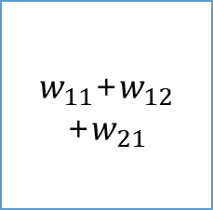
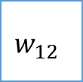
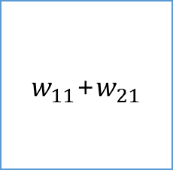
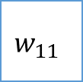
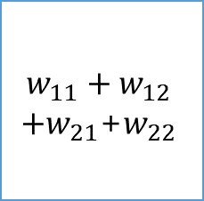
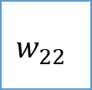
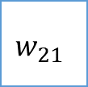
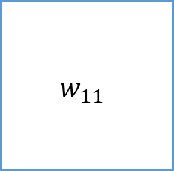
CNN
BackPropagation
$$w_{11}+w_{12}$$
${+w}_{21}$+$w_{22}$
$w_{11}$+$w_{21}$
1
1
0
$$w_{11}$$
$$w_{12}$$
1
1
0
$w_{11}$+$w_{12}$
+$w_{21}$
$$w_{11}$$
$$w_{21}$$
$$w_{22}$$
1
0
0
Image
2X32Kernel
Convolved Feature

Slide 23









CNN
BackPropagation
$$x_{11}$$
$$x_{12}$$
$$x_{13}$$
$$x_{21}$$
$$x_{22}$$
$$x_{23}$$
$$x_{31}$$
$$x_{32}$$
$$x_{33}$$
Input Feature Map
Conv
출처 : https://ratsgo.github.io/deep%20learning/2017/04/05/CNNbackprop/

Slide 24


















CNN
BackPropagation
$$x_{11}$$
*
$$σ_{21}$$
$$x_{12}$$
$$σ_{22}$$
*
+
$$σ_{11}$$
$$x_{21}$$
$$σ_{23}$$
*
$$x_{22}$$
$$σ_{24}$$
*
$$w_{11}$$
P
F(x)
$$x_{12}$$
*
$$σ_{25}$$
$$x_{13}$$
*
$$σ_{26}$$
+
$$σ_{12}$$
$$x_{22}$$
*
$$σ_{27}$$
$$x_{23}$$
$$σ_{28}$$
*
$$w_{12}$$

Slide 25

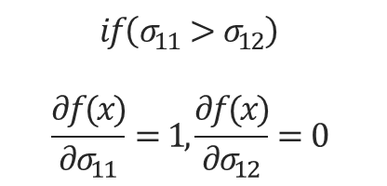














Output
Size
$$f\left(x\right)=maxpool(σ_{11},σ_{12})$$
$σ_{11}$=$σ_{21}$+$σ_{22}$+$σ_{23}$+$σ_{24}$
$σ_{21}$=$x_{11}∗w_{11}$
$$\frac{∂σ_{21}}{∂w_{11}}=x_{11}$$
$σ_{12}$=$σ_{25}$+$σ_{26}$+$σ_{27}$+$σ_{28}$
$σ_{22}$=$x_{12}∗w_{11}$
$$\frac{∂σ_{22}}{∂w_{11}}=x_{12}$$
$σ_{23}$=$x_{21}∗w_{11}$
$σ_{24}$=$x_{22}∗w_{11}$
$$if\left(σ_{11}>σ_{12}\right)$$
$$\frac{∂f(x)}{∂σ_{11}}=1,\frac{∂f(x)}{∂σ_{12}}=0$$
$σ_{25}$=$x_{12}∗w_{12}$
$$\frac{∂σ_{1n}}{∂σ_{2n}}=1$$
$\frac{∂f(x)}{∂w_{11}}=x_{11}+x_{12}$+$x_{21}$+$x_{22}$
$σ_{26}$=$x_{13}∗w_{12}$
$σ_{27}$=$x_{22}∗w_{12}$
$σ_{28}$=$x_{23}∗w_{12}$

Slide 26
감사합니다
THANK YOU

